Slide 1
AirKitchen:
Week7 Update
Team FoodXYZ
Mengdan Yuan, Wen Xin

Slide 2

https://img.huffingtonpost.com/asset/585be1aa1600002400bdf2a6.jpeg?ops=scalefit_970_noupscale

Slide 3
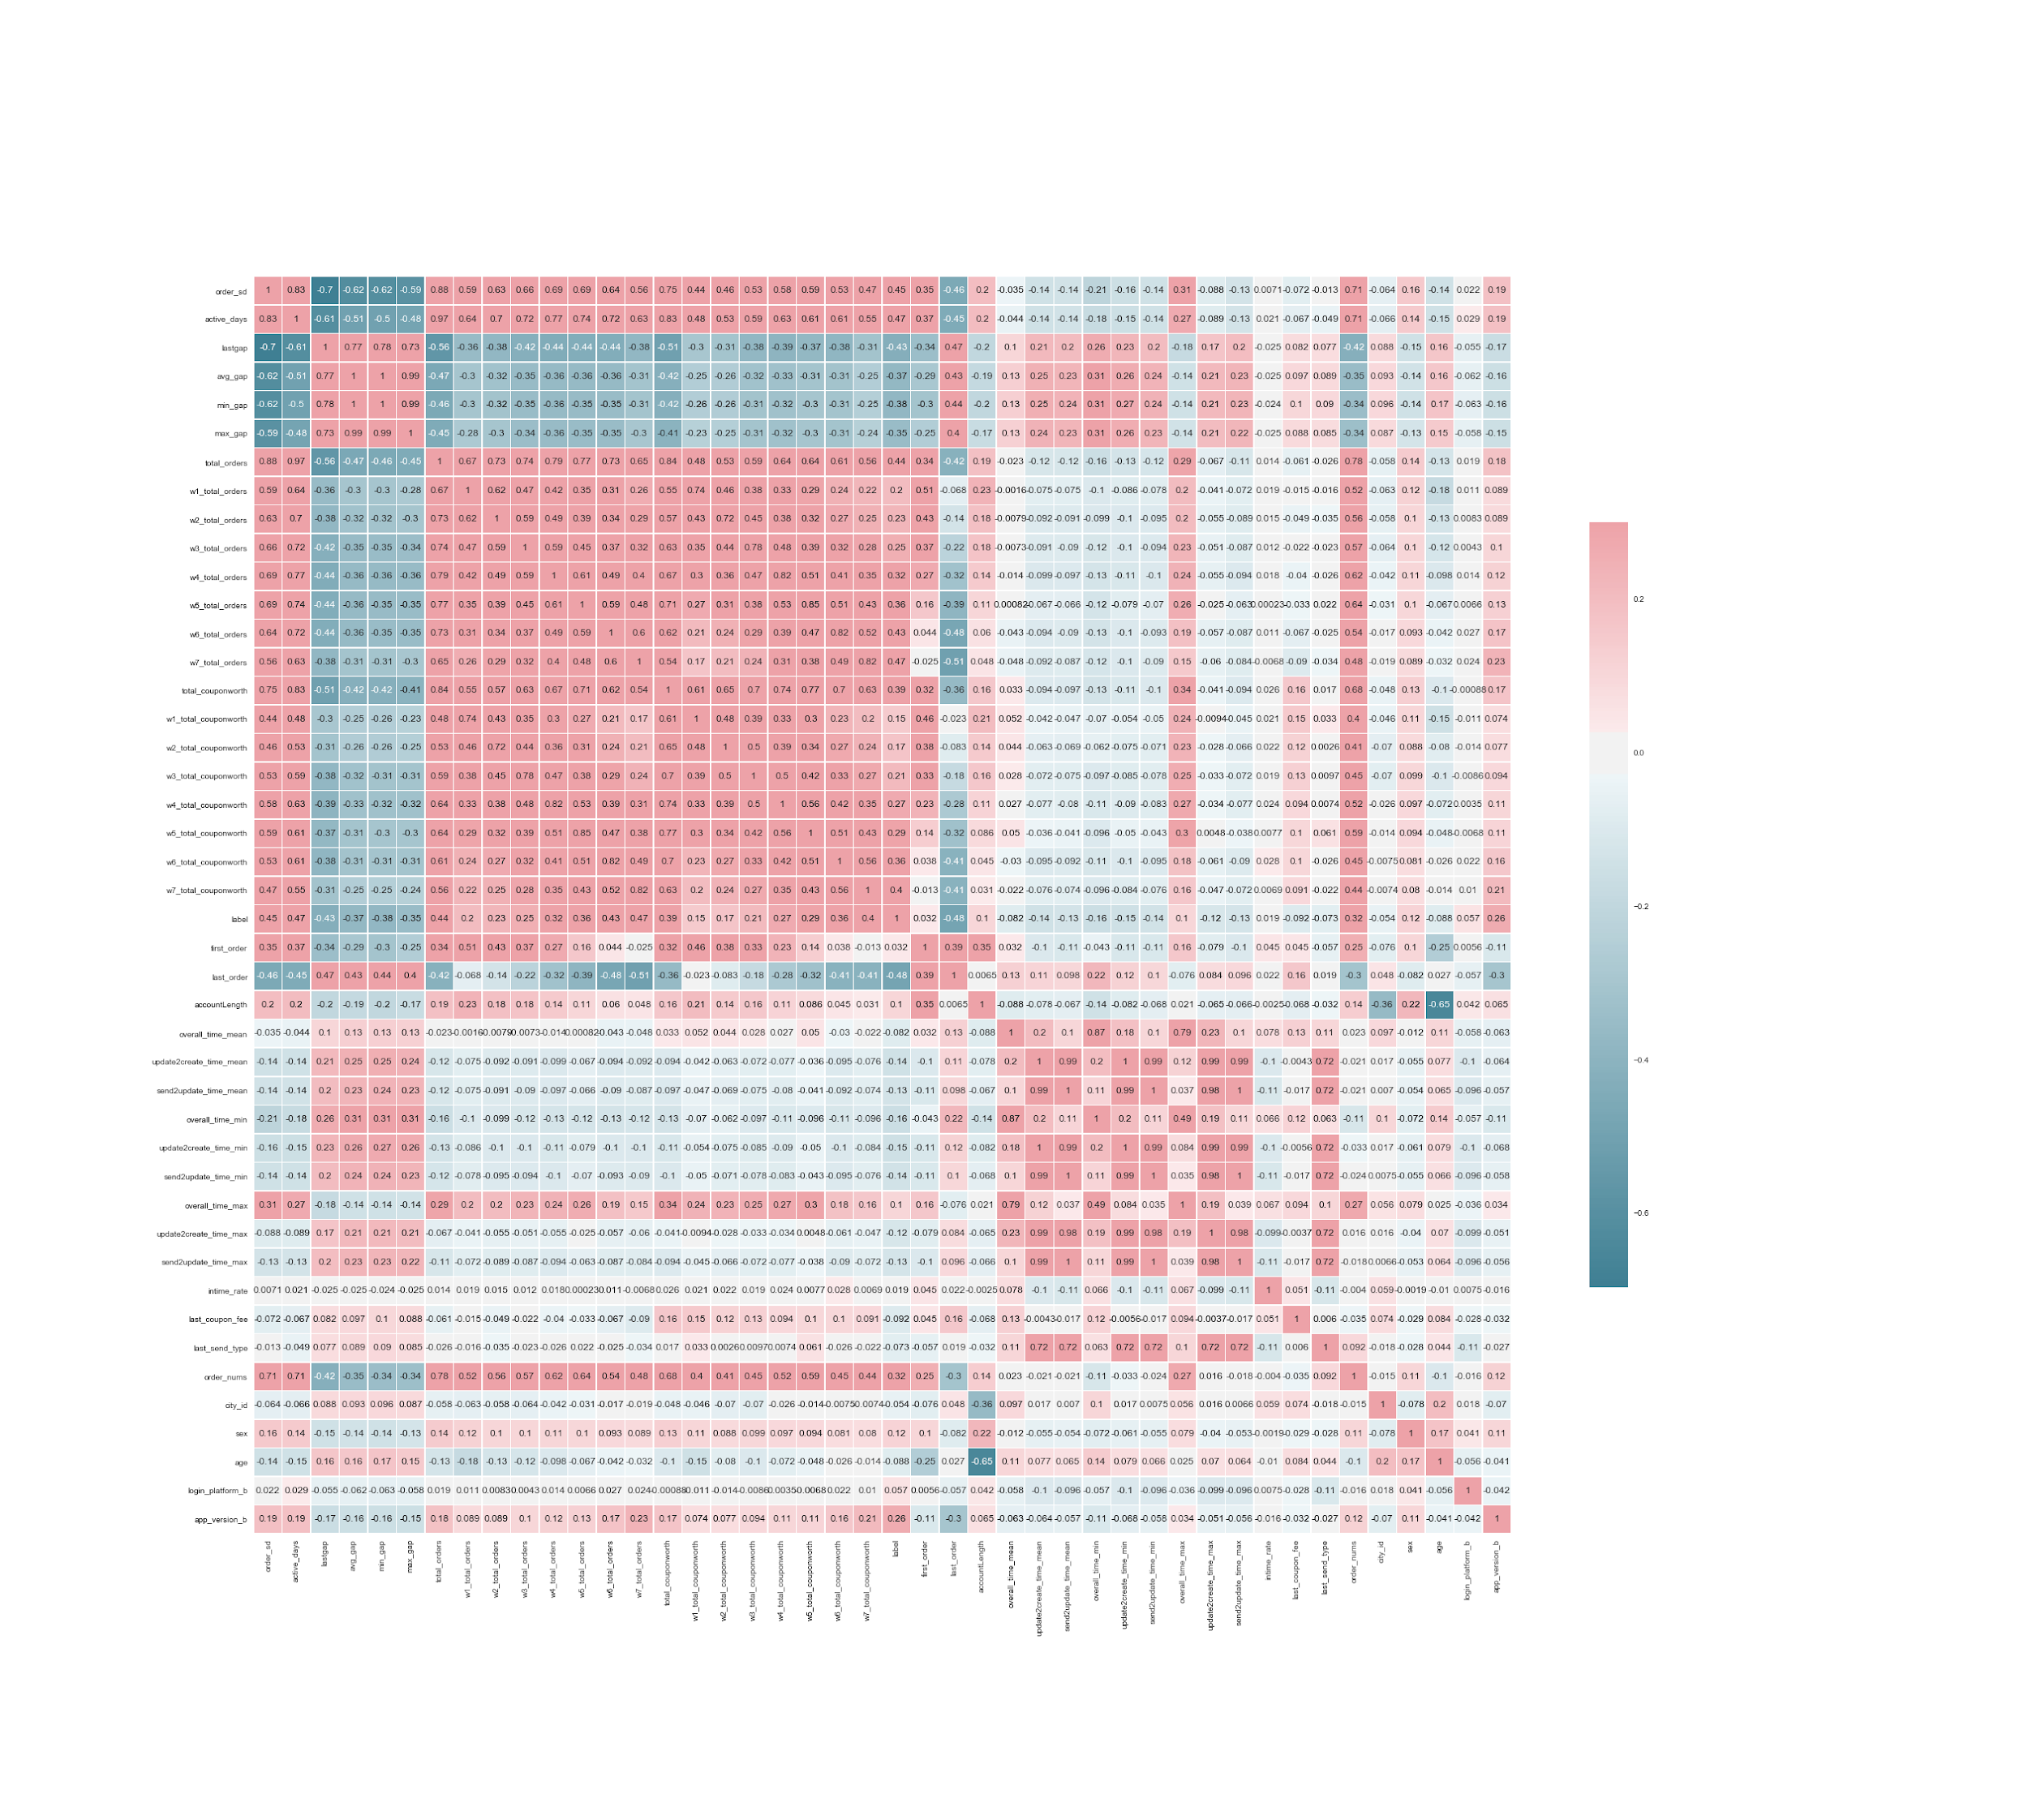
Feature Selection & Clean Data
Visualize correlation matrix to identify useful/useless features
Exp: occupation, invite_code
Draw distribution of each variable, fill in NA
Exp: 100 for gap features
Transform some features
Exp. app version prev 2.8 and post 2.8

Slide 4
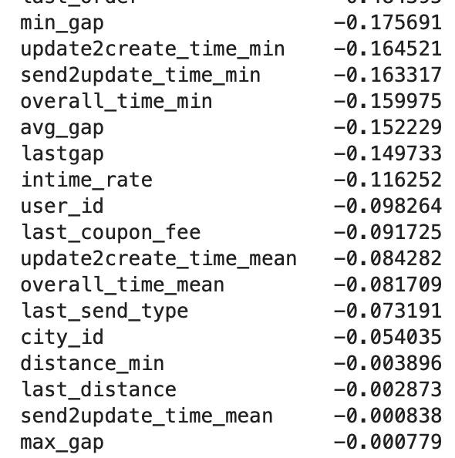
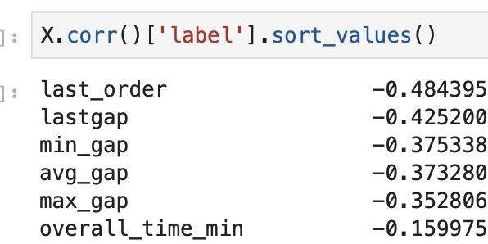
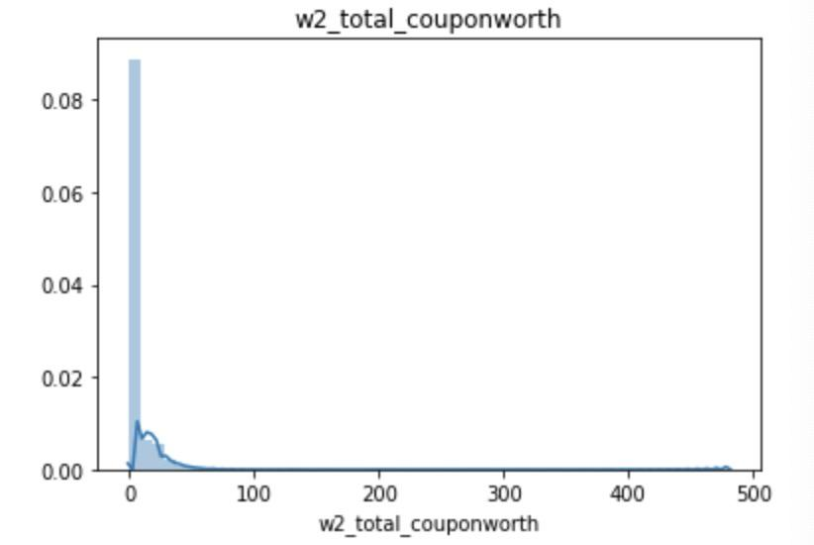
EDA with new data
Correlation matrix
The correlations between some features and the label improve a lot.
Distribution of each variable
Most variable has a long tail(may need log transform while using linear model)

Slide 5
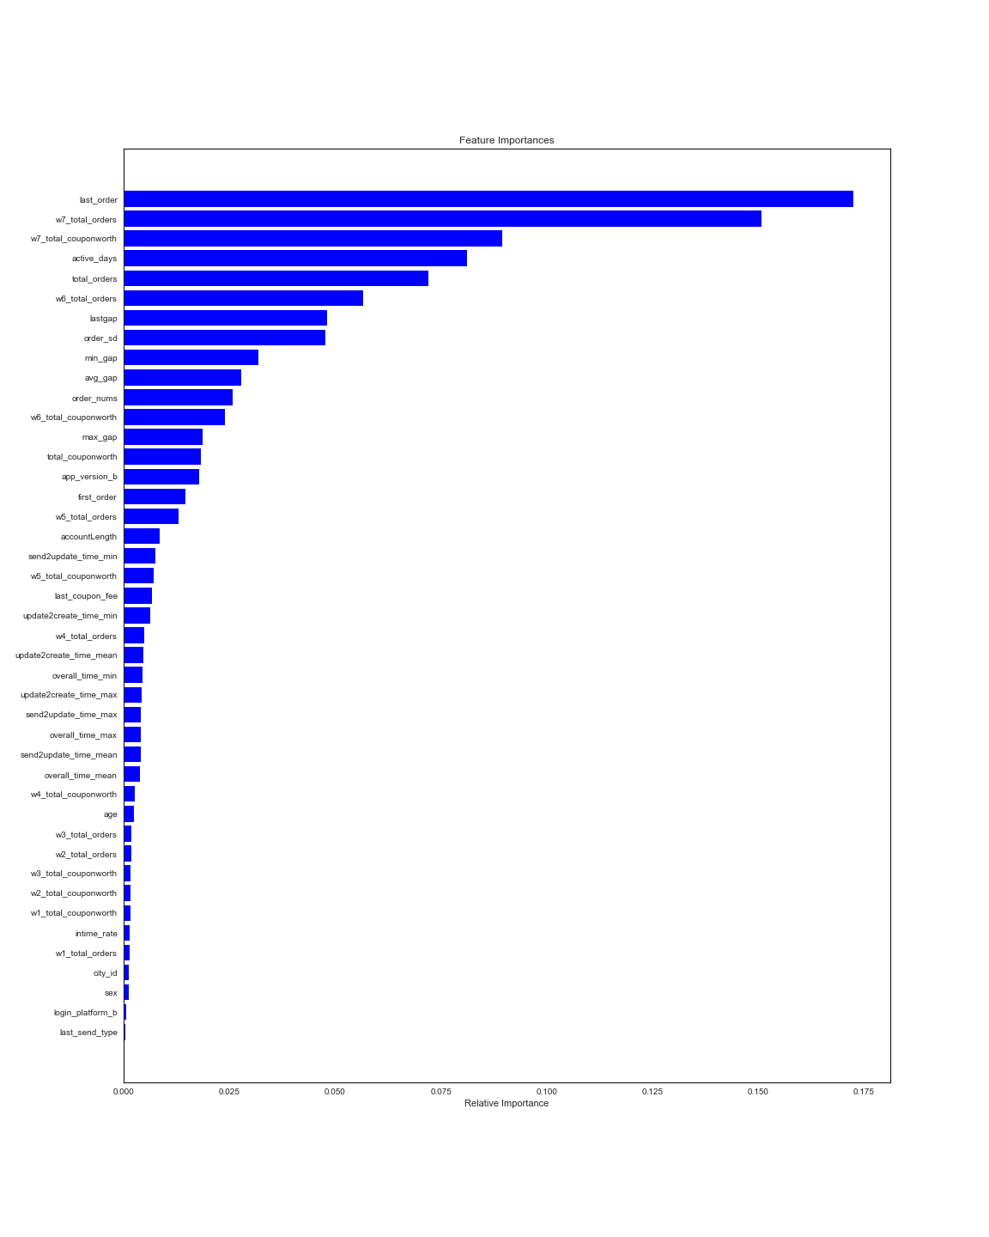
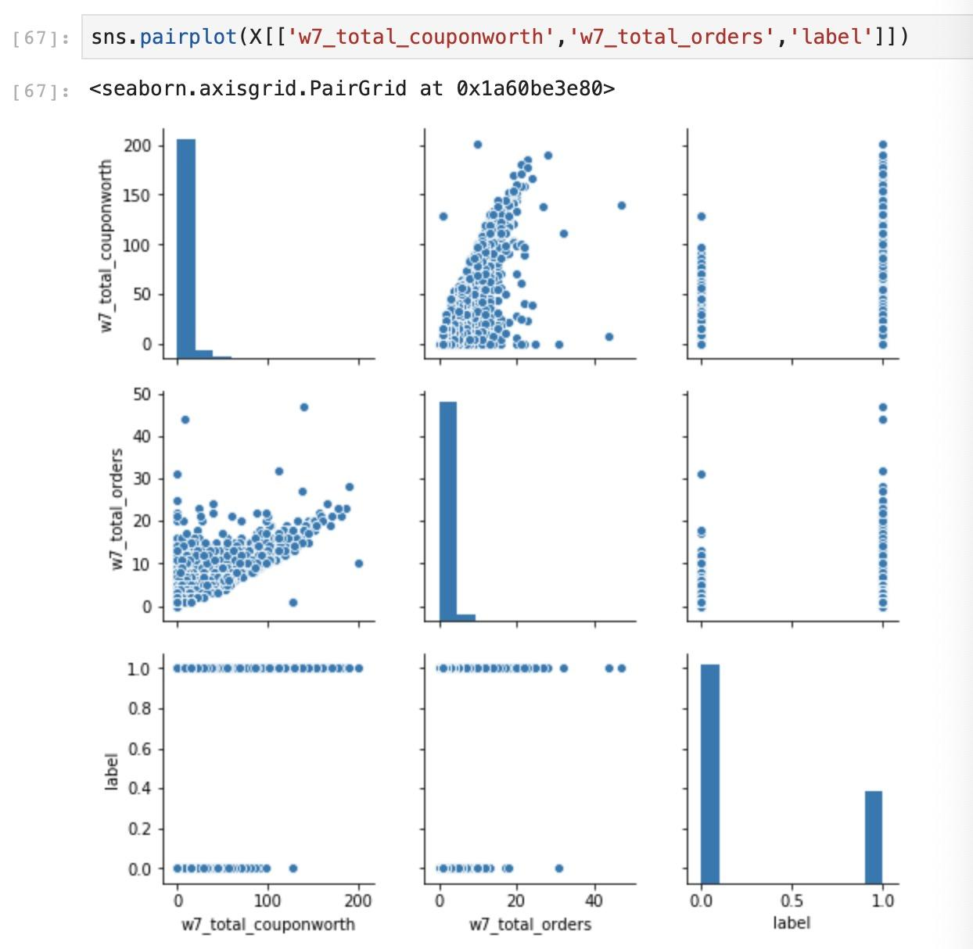
3. Draw pair plot to find highly correlated features
Coupon worth and orders has high correlation.
4. Feature importance from Random Forest

Slide 6
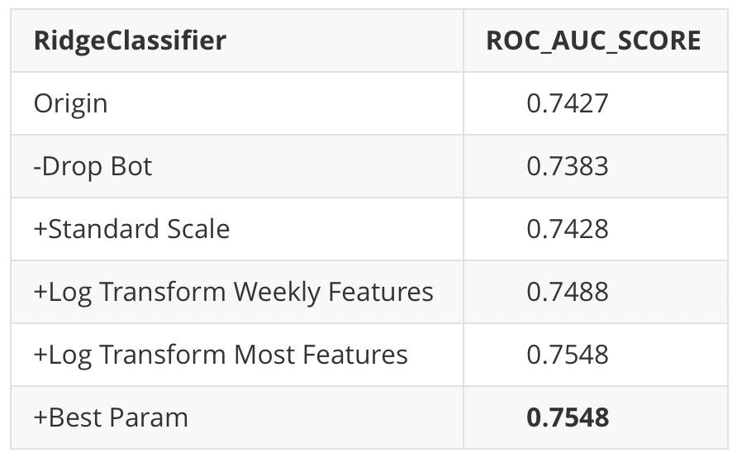
Baseline Models
Baseline Models: RidgeClassifier/Logistic Regression
Metric: ROC_AUC_SCORE
Logistic Regression | ROC AUC SCORE
Default | 0.7535
Standardized | 0.7570
Log transform+regulization | 0.7629

Slide 7
Next Steps
Feature Selection 2
Try fancy models: lightGBM

